Slide 1



Financial Analysis and Evaluation
“An In-depth Review of Performance, Trends, and Strategic Insights”

Slide 2
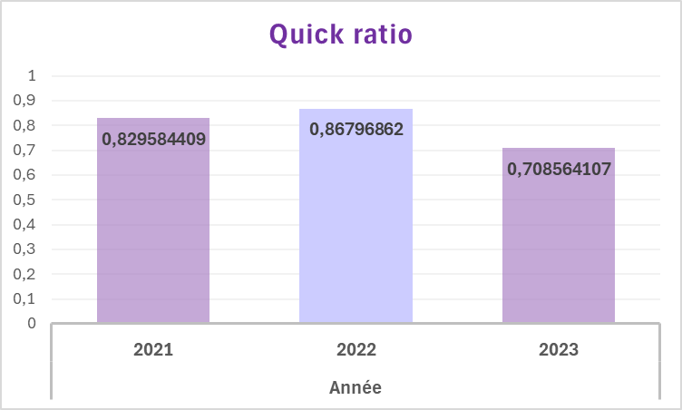
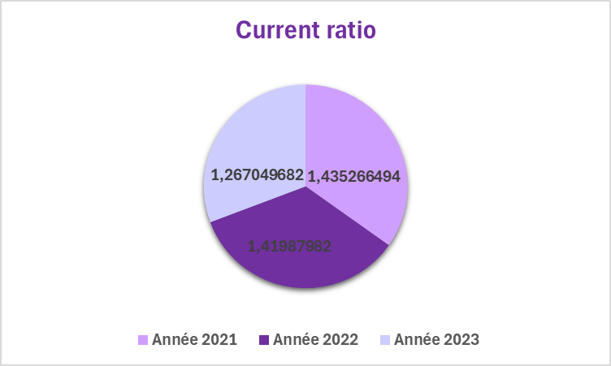
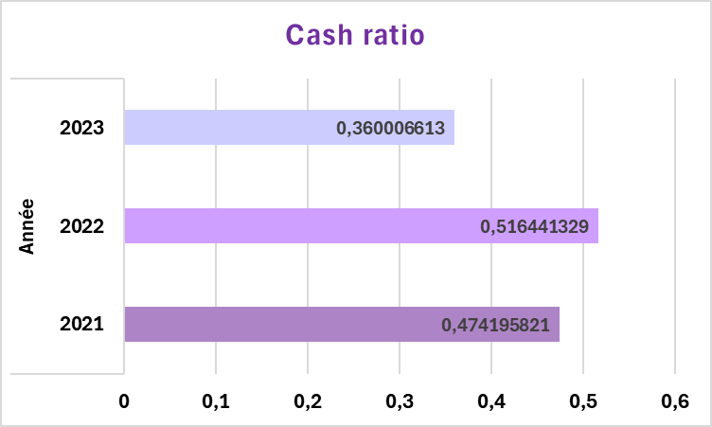
Liquidity Analysis
Liquidity ratio | Année
 | 2021 | 2022 | 2023
Current ratio | 1,43526649 | 1,41987982 | 1,26704968
Quick ratio | 0,82958441 | 0,86796862 | 0,70856411
Cash ratio | 0,47419582 | 0,51644133 | 0,36000661
Profitability Liquidity Leverage Valuation

Slide 3
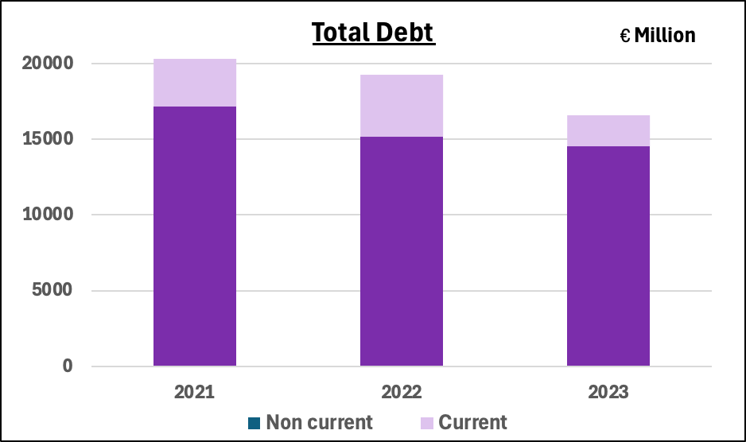
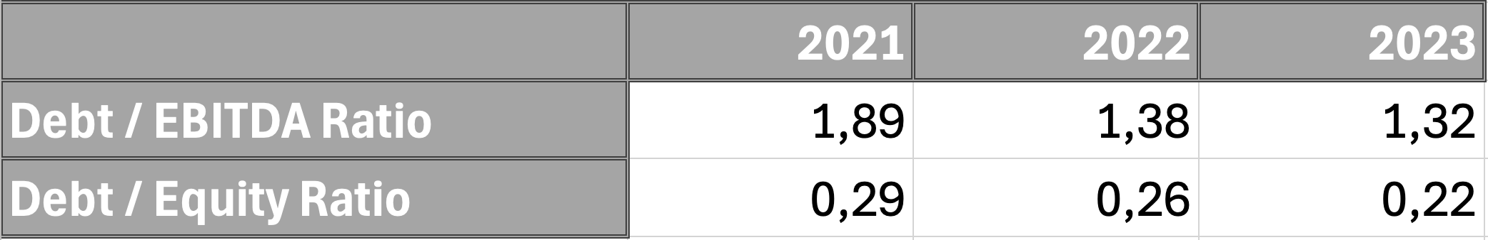
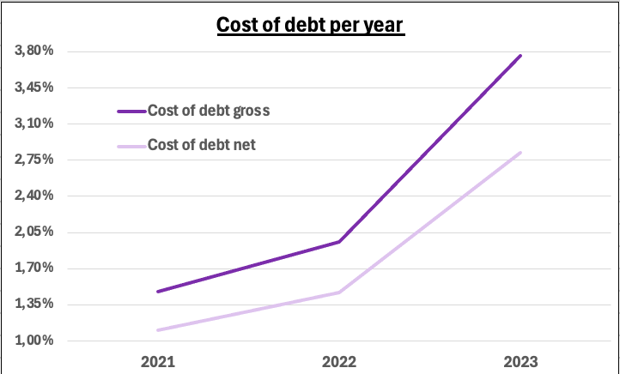
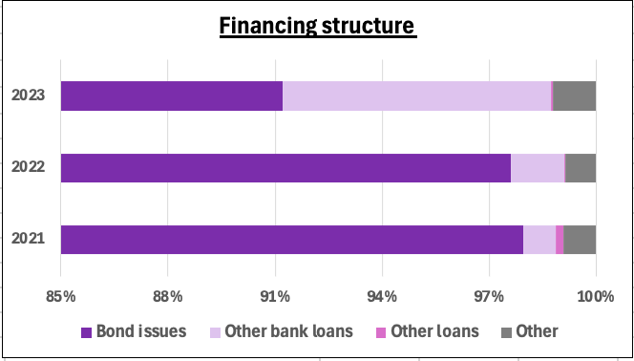
Financial Leverage Analysis
Profitability | Liquidity | Leverage |  | Valuation

Slide 4

Financial Growth and Projections….
Sum of Discounted FCF : €22,627 M
Net Debt : €7,682 M
Discounted Terminal Value (TV) : €48,185 M
€56M
7.02% CAGR
€38M
Enterprise Value (EV) : €70,813 M
Equity Value (EQ) : €63,131M
Profitability | Liquidity | Leverage |  | Valuation
Terminal Growth Rate
WACC

Slide 5
Buy Rating: Our Target
€ 63.1 B
6 % FCFF CAGR 2024-2028
Enterprise Value
BUY
€ 56.60
Target Price
7.02% WACC
50%
2024-2028
50%
2024-2028
2% Terminal Growth Rate
Profitability | Liquidity | Leverage |  | Valuation

